Slide 1
Introduction to AI/ML
Ebelechukwu Nwafor, Ph.D.
Assistant Professor, Villanova University

Slide 2

About Me
Visiting Assistant Professor
Howard University-Google Tech Exchange
Research Intern
IBM Almaden
Cheyney University
Assistant Professor
BA, Computer & Information Science
Villanova University
Howard University
PhD, Computer Science
Norfolk State University
MS, Computer Science

Slide 3
Goal
The goal of this module is to provide a high-level introduction of the foundations of Artificial Intelligence and Machine Learning (ML)
By the end of this module, you will be able to:
Understand the principles of AI and ML
Provide key distinctions between both concepts
Hands on experience on the ML workflow

Slide 4
Agenda
Module 1 (Jan 31): Introduction to AI and ML
What is Artificial Intelligence
Understanding Machine Learning
Types and Applications of AI
Real World Case Studies of AI/ML in Healthcare
Ethical Considerations in AI
Emerging Trends and Future of AI
Discussions

Slide 5
Agenda
Module 2 (Feb 1): Introduction to AI and ML Algorithms
Supervised Learning (e.g. Linear Regression, Decision Trees)
Unsupervised Learning Algorithms (e.g. Clustering, PCA)
Basics of Neural Networks and Deep Learning
Training ML models
Model Evaluation and Validation Techniques
Overfitting, Underfitting, and Model tunning

Slide 6
What is Artificial Intelligence?
AI is a branch of computer science aimed at building machines capable of performing tasks that typically require human intelligence.
These tasks include learning, reasoning, problem-solving, understanding natural language, and perception.
Artificial Intelligence
Notes:
Mimicking the intelligence or behavioral pattern of humans or any other living entity.

Slide 7
History and Evolution of AI

Slide 8
Types of AI
Narrow AI
Subsystem designed to perform specific tasks (e.g. virtual assistants such as Alexa and Siri, recommendation systems such as algorithms for recommending movies on Netflix).
General AI
Theoretical systems with human-like intelligence across a wide range of tasks engage in meaningful conversations, and learn new games or skills without being explicitly programmed for them. As of now, there are no real world examples of General AI because it remains a theoretical concept.
Superintelligent AI
An AI system that can surpass human intelligence in scientific creativity, general wisdom, and social skills. This is still highly theoretical.

Slide 9
Types of AI
Narrow AI
Performs specific tasks (e.g. Siri, Alexa, Netflix recommendations).
Task-specific systems without general understanding.
General AI
Theoretical concept of AI with human-like intelligence
Capable of understanding, learning, and applying knowledge across various tasks.
No real-world examples yet; remains speculative
Super intelligent AI
AI that exceeds human intelligence and capability
Encompasses scientific creativity, wisdom, and social skills
Highly theoretical and speculative with no current real-world instances.

Slide 10
Subfields of AI
Machine Learning: Focus on algorithms that enable machines to learn from data.
Deep Learning: A subset of ML, involving neural networks with many layers, enabling the recognition of patterns from unstructured data.
Natural Language Processing (NLP): Enables machines to understand and interpret human language.
Robotics: The design and creation of robots that can perform tasks autonomously or semi-autonomously.
Computer Vision: Enables machines to interpret and make decisions based on visual data.

Slide 11
Subfields of AI
Machine Learning (ML):
Algorithms that allow machines to learn from data.
Deep Learning:
A subset of ML using multi-layered neural networks.
Recognizes complex patterns in large datasets.
Natural Language Processing (NLP):
Technology enabling machines to understand human language.
Robotics:
Design and creation of robots for autonomous or semi-autonomous tasks
Computer Vision:
Allows machines to interpret visual data and make decisions.

Slide 12
Machine Learning

Slide 13
What is Machine Learning?
Machine Learning is a subset of AI that focuses on the development of algorithms that can learn to make predictions or decisions based on data.
This learning can improve over time with more data and experiences.
Artificial Intelligence
Machine Learning

Slide 14
ML vs. Traditional Programming
Traditional Programming
Relies on explicit rules and instructions defined by developers
Works well for tasks with clear, deterministic algorithms.
Machine Learning
Learns patterns from data and makes decisions or predictions
Ideal for complex tasks where rules are not easily definable.
Notes:
Traditional Programming
Rule-Based Decision Making:
Developers write explicit rules (if-else statements, loops) to process data and make decisions.
The logic and instructions are defined by programmers based on known conditions.
Input and Output:
Input: Data and predefined rules.
Output: Answers or decisions based on those rules.
Limitations:
Struggles with complex tasks where defining explicit rules is impractical.
Cannot adapt to new data or situations not accounted for in the rules.
Examples:
A calculator program that performs operations based on user input.
Form validation in web applications.
Machine Learning
Data-Driven Learning:
Algorithms learn from data, identifying patterns and making decisions with minimal human intervention.
The 'rules' are inferred from the data, allowing the system to adapt to new scenarios.
Input and Output:
Input: Data and historical answers (especially in supervised learning).
Output: Predictions or decisions made by the model.
Advantages:
Can handle complex tasks that are difficult to solve with traditional programming.
Continuously improves as it processes more data.
Examples:
A spam filter that learns to identify spam emails from patterns in data.
Recommendation systems that suggest products based on user behavior.
Key Differences
Flexibility:
Traditional Programming: Static and requires updates for new conditions.
ML: Dynamic and can adapt to new data or changes over time.
Complexity Handling:
Traditional Programming: Best for straightforward tasks with clear rules.
ML: Excel at complex pattern recognition and tasks with ambiguous rules.
Development Approach:
Traditional Programming: Logic first, then data.
ML: Data first, then logic (patterns) is derived.

Slide 15
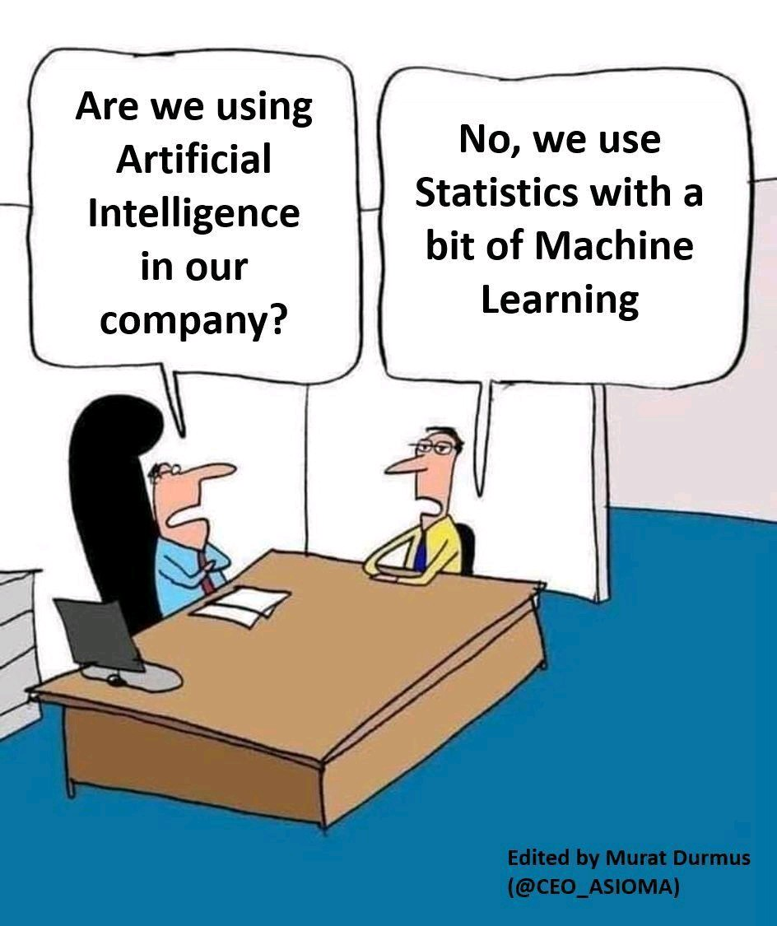
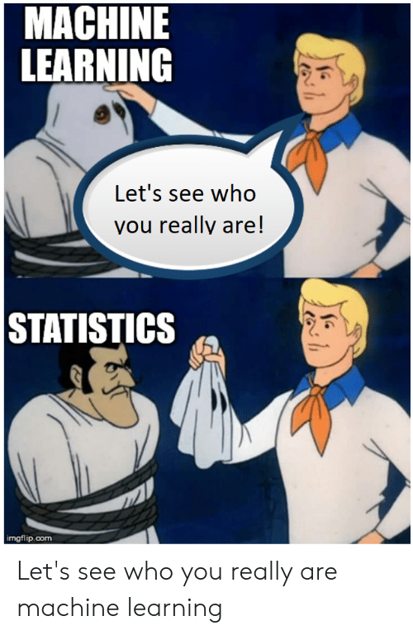
ML uses a lot of statistics…

Slide 16
AI vs ML – What’s the difference?
AI (Artificial Intelligence)
Broad field aiming to create machines capable of intelligent behavior
Encompasses reasoning, learning, perception, and language understanding
The goal is to achieve both narrow (task-specific) and general (human-like) intelligence.
ML (Machine Learning)
A subset of AI focused on algorithms that learn from data
Employs statistical methods to enable machines to improve tasks with experience
Primarily concerned with prediction and pattern recognition

Slide 17
What part of AI is not ML?
Expert Systems
Mimic the decision-making ability of human experts
Robotics
Designing and building robots to perform tasks which may not always incorporate learning algorithms
Search Algorithms
Algorithms like A* or Dijkstra's for pathfinding and optimization, which don’t learn from data but are designed to solve specific problems
Evolutionary Algorithms

Slide 18
Applications of Machine Learning - Finance
Application: PayPal uses ML algorithms to combat fraud by analyzing millions of transactions. These algorithms learn to distinguish between legitimate and fraudulent transactions based on patterns and anomalies.
Impact: Reduces false positives, enhances customer experience, and minimizes financial losses due to fraud.

Slide 19
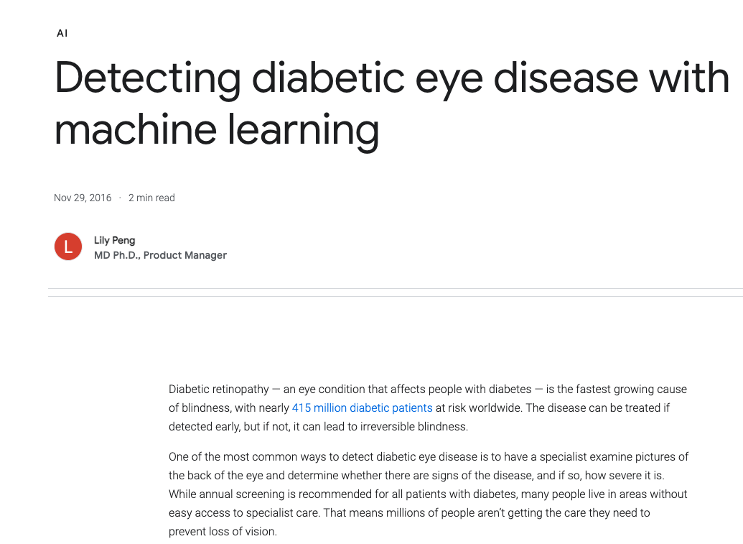
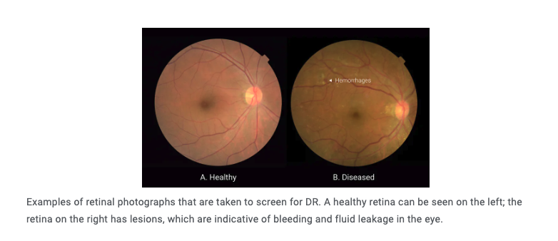
Applications of Machine Learning - Healthcare
Application: Google Health developed a machine learning model to screen for diabetic retinopathy (DR), a condition that can lead to blindness if untreated. The model analyzes retinal images to detect signs of the disease.
Impact: The automated screening tool can assist doctors in diagnosing and treating diabetic retinopathy more efficiently, especially in underserved communities with limited access to ophthalmologists.
Source: https://blog.google/technology/ai/detecting-diabetic-eye-disease-machine-learning/

Slide 20
Applications of Machine Learning - Agriculture
Application: John Deere integrates ML into its agricultural equipment to enable precision farming, using data from sensors and satellites to make informed decisions about planting, fertilizing, and harvesting.
Impact: Increases crop yields and sustainability by optimizing resource use.

Slide 21
Applications of Machine Learning - Marketing
Application: Coca-Cola uses ML to analyze data from various sources to gain insights into consumer preferences and trends, influencing marketing strategies and product development.
Impact: Drives innovation and targeted marketing, leading to more effective campaigns and product offerings.

Slide 22
Applications of Machine Learning – Predictive Maintenance
Application: Siemens employs ML for predictive maintenance in its manufacturing operations, using IoT (Internet of Things) sensor data to predict equipment failures before they occur.
Impact: Reduces downtime and maintenance costs, improving overall efficiency and productivity in manufacturing processes.
For more case studies, check out: https://pytorch.org/community-stories

Slide 23
In class Activity
Group discussion on AI products you use in your daily lives

Slide 24
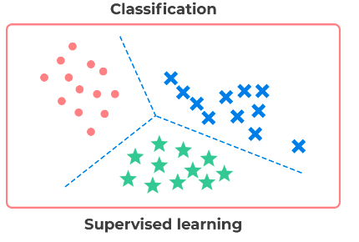
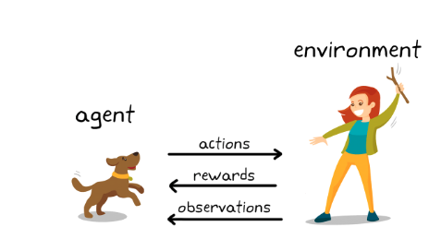
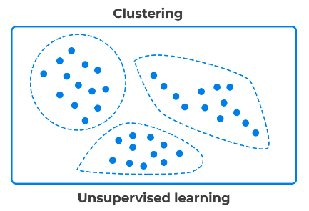
Types of Machine Learning Approach
Supervised Learning
Models learn from labeled data.
Predictions based on input-output pairs.
Unsupervised Learning
Identifies patterns in unlabeled data.
Clusters similar data points together.
Reinforcement Learning
Learns by trial and error from actions in an environment.
Aims to achieve defined goals.

Slide 25
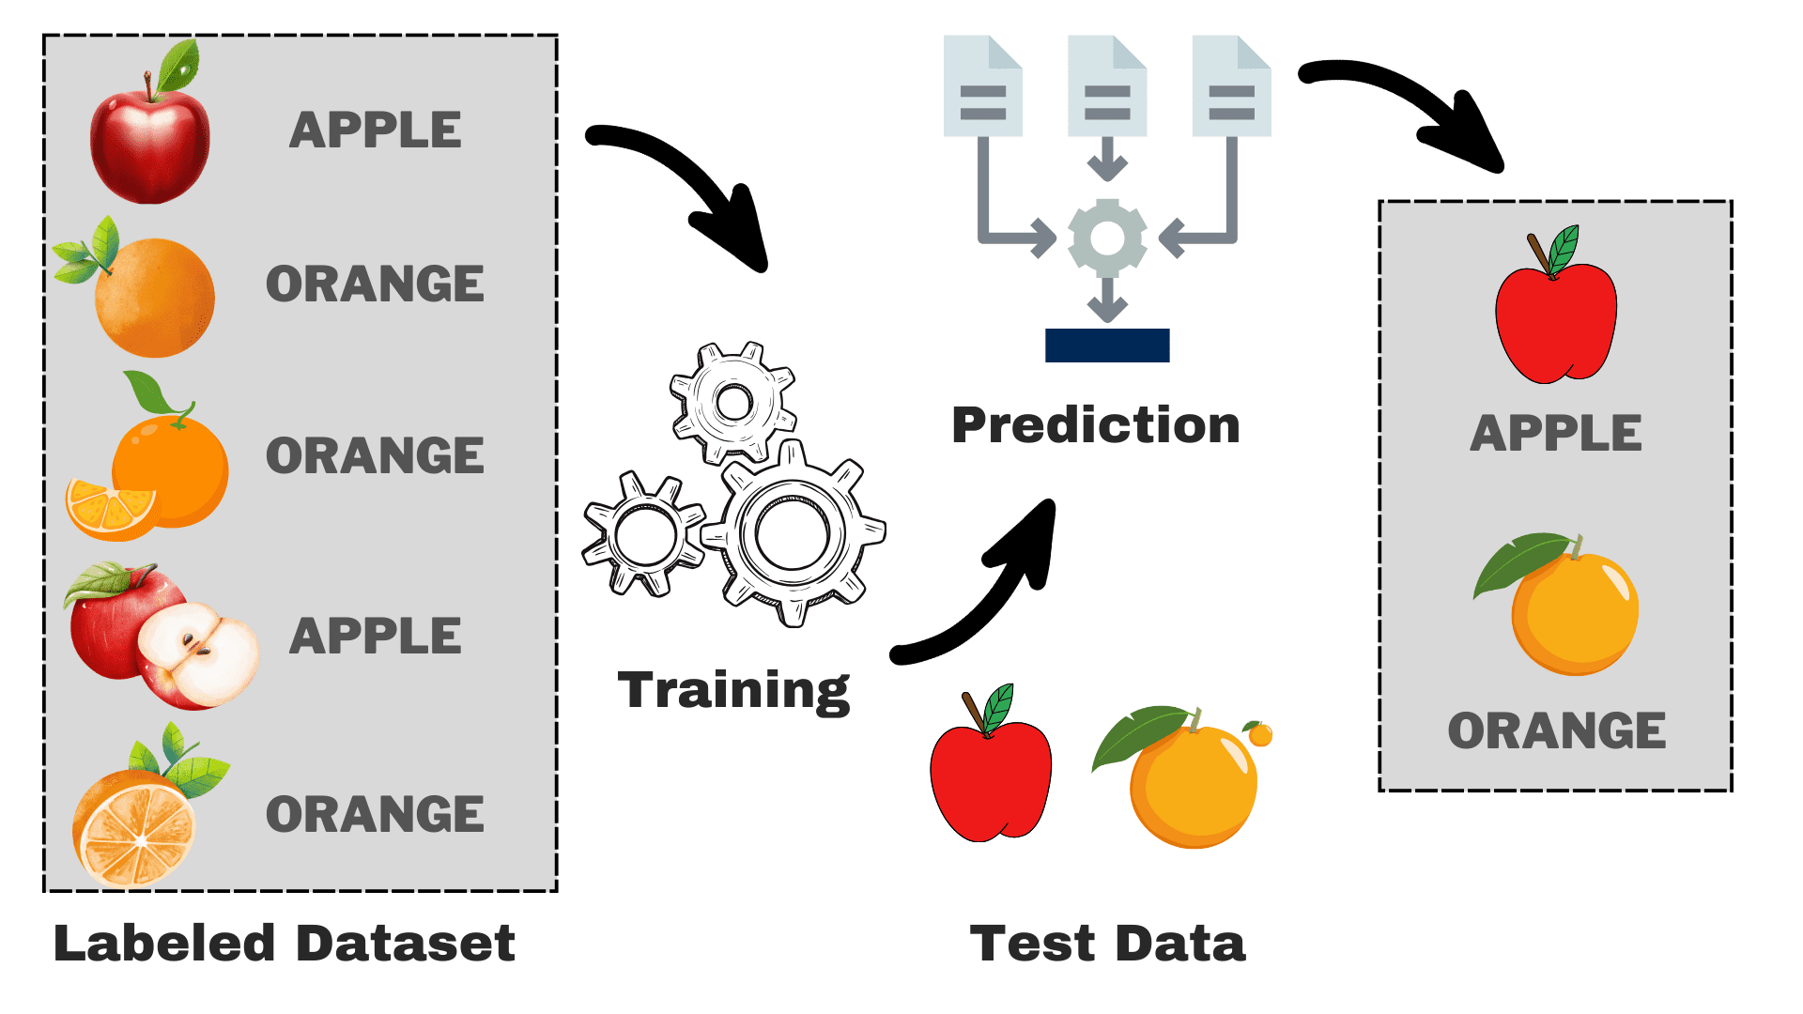
Supervised Learning – Fruit Labeling Analogy
Training Phase:
Demonstrate sorting fruits (apples, Oranges)
Each fruit type and its corresponding basket acts as labelled examples
Prediction Phase
Machine learning model sorts a new basket of fruits independently
Uses knowledge from training to recognize and categorize new fruits
Image source: https://www.kdnuggets.com/understanding-supervised-learning-theory-and-overview

Slide 26
Supervised Learning Overview
Definition:
Trains model on labeled dataset
Each example has an input vector and a corresponding output label.
Goal:
Learn a function mapping inputs to outputs
Use this function for predictions on new data
Types of Problems:
Classification:
Output is categorical (e.g. Spam detection, disease diagnosis)
Regression:
Output is a continuous value (e.g. house price prediction, weight estimation based on height).

Slide 27
Some Supervised Learning Algorithms
Classification
Logistic Regression
Support Vector Machines
Random Forest
Regression
Linear Regression

Slide 28
Unsupervised Learning – Book sorting Analogy
No categories provided; task is to organize books logically.
Process: Identify patterns (size, color, topic) to create groups.
Similar to clustering algorithms finding inherent data groupings.
Analogy Insight:
Unsupervised learning discovers data patterns and structures without labels.

Slide 29
Unsupervised Learning Overview
Definition:
Machine learning without explicit labels or targets.
Identifies patterns and structures in input data.
Applications:
Discovers hidden patters and correlations.
Useful for data exploration and enhancing model efficiency.
Challenges:
Results can be difficult to interpret without “ground truth”
Main Types:
Clustering Algorithms:
Groups data based on similarities
Dimensionality reduction:
Reduces variables, preserving essential features.

Slide 30
Some Unsupervised Learning Algorithms…
Clustering
K-means
Hierarchal Clustering
Density-based Spatial Clustering of Applications with Noise (DB-SCAN)
Dimensionality Reduction Algorithms
Principal Component Analysis (PCA)
t-SNE

Slide 31
Reinforcement Learning –Dog Training Analogy
Agent:
The dog represents the learning agent.
Environment:
Surroundings where the agent operates, including the human.
Actions:
Dog’s behaviors, such as sit, fetch, or stay.
Observations:
Feedback from the environment, like human gestures or commands.
Rewards:
Positive reinforcement like treats or praise when the dog performs the desired action.
Notes:
This is an analogy for reinforcement learning where the dog learns to perform actions based on rewards given by the trainer for correct behaviors, similar to how a machine learning model would learn by receiving rewards for correct predictions or actions within a given environment.

Slide 32
Reinforcement Learning Overview
Definition:
A type of machine learning where an agent learns to make decisions by performing actins and observing rewards
Process:
Agent interacts with an environment, takes actions, and receives rewards or penalties
Goals is to maximize the cumulative reward over time.
Key components:
Agent: Learns from the environment to perform tasks.
Environment: The domain or situation the agent operates in
Actions: The set of possible moves or decisions the agent can make
Rewards: Feedback signals that evaluate the success of an action

Slide 33
Reinforcement Learning Overview (cont’d)
Applications:
Gaming (e.g., AI playing chess or Go).
Autonomous vehicles (eg., learning to drive through simulation).
Robotics (e.g., robots learning to navigate obstacles).

Slide 34



Reinforcement learning examples
Simulated stick figure learns to walk
Robot learns to walk with no input
Waymo’s self-driving car

Slide 35
Machine Learning Workflow
Data Collection:
Gather diverse and representative datasets relevant to the problem
Data Preparation:
Clean and preprocess data for compatibility with ML models.
Model Training:
Feed prepared data into algorithms to learn and identify patterns
Evaluation:
Assess model performance with metrics like accuracy, precision, recall, F1 Score
Deployment
Implement the trained model for real-world predictions and decisions

Slide 36
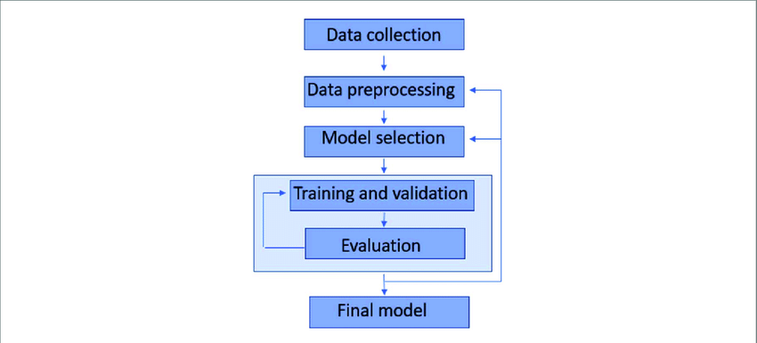
Machine Learning Workflow

Slide 37
Data is the new oil…
Data is the cornerstone for every machine learning approach.
High-quality, large dataset lead to more accurate and reliable models.
Quality includes relevance, cleanliness, and diversity of data
But how do we ensure that we have properly sanitized our input data before machine learning is applied?

Slide 38
Data Preparation Techniques
Definition:
The process of cleaning and transforming raw data before analysis.
Key steps:
Data cleaning:
Handle missing values
Correct errors and remove outliers
Data Transformation:
Normalize or scale features
Encode categorical data
Feature Selection:
Identify and select the most relevant features for analysis
Data Splitting:
Divide data into training, validation, and test sets.
Notes:
Importance:
Enhances model accuracy and performance.
Reduces complexity, improving training efficiency.
Tools & Techniques:
Software libraries like Pandas, Scikit-learn in Python.
Techniques such as imputation, one-hot encoding, PCA for dimensionality reduction.

